Slide 1
Entrepreneurship Development
Introduction: Discover yourself-Find you Flow, Effectuation,Identify your Entrepreneurial Style

Slide 2
Definitions
Entrepreneurship is the process of designing, launching and running a new business offering a product, process or service for sale or hire.
The people who create these businesses are called Entrepreneurs.
The project or undertaking that is especially difficult, complicated or risky is known as Enterprises.
(The person/ The Actor) ( The process/The Act) ( The outcome)
Entrepreneur
Entrepreneurship
Enterprise

Slide 3
The word "entrepreneur" is derived from a French root ‘entreprendre’, meaning, "to undertake” and is commonly used to describe an individual who organizes and operates a business or businesses, taking on financial risk to do so.
The term "entrepreneur" seems to have been introduced into economic theory by Cantillon (1755)
An entrepreneur is a person who starts an enterprise. He searches for change and responds to it.
Entrepreneur is someone who perceives opportunity, organizes resources needed for exploiting that opportunity and exploits it.

Slide 4
What is Entrepreneurship?
Entrepreneurship is the process of setting up one’s own business as distinct from pursuing any other economic activity, be it employment or practicing some profession. The person who set-up his business is called an entrepreneur.
Entrepreneurs not only search for new market demand, but also create demand by studying the market
Example:
Just opening a new restaurant is neither innovative nor entrepreneurial
McDonald’s – while it did not invent anything, it is an entrepreneurship
By applying mgmt concepts and mgmt techniques
standardizing the “product”
designing process and tools
by training on the analysis of the work to be done and then setting the standards it required
McDonald’s both drastically upgraded the yield from resources, and created a new market and a new customer

Slide 5
E: xamine needs, wants, and problems to see how they can improve the way needs and wants are met and problems overcome.
N: arrow the possible opportunities to one specific "best" opportunity.
T: hink of innovative ideas and narrow them to the "best" idea.
R: esearch the opportunity and idea thoroughly.
E: nlist the best sources of advice and assistance that they can find.

Slide 6
P: lan their ventures and look for possible problems that might arise.
R: ank the risks and the possible rewards.
E: valuate the risks and possible rewards and make their decision to act or not to act.
N: ever hang on to an idea, no matter how much they may love it, if research shows it won't work.
E: mploy the resources necessary for the venture to succeed.
U: nderstand that they will have to work long and hard to make their venture succeed.
R: ealize a sense of accomplishment from their successful ventures and learn from their failures to help them achieve success in the future.

Slide 7
Factors Affecting Entrepreneurship

Slide 8
Factors affecting Entrepreneurship
Individual factors
Political Factors
Economic Factors
Social Factors
Technological Factors
Ecological Factors
Legal factors

Slide 9
Individual Factors
Desire to do something
Technical Background
No. of years of experience
Occupational background-
Educational background-
Parental background
Sometimes children continue their family business and make some changes in the existing business in the form of some new technology, new process, new product etc. they are called second generation entrepreneur.

Slide 10
Political Factors
The extent and process of government direct or indirect intervention and influence on businesses in an economy.
Political factors include
tax policy, labour law, environmental law, trade restrictions etc.
Political factors may also include goods and services which the government wants to provide or be provided (merit goods) and those that the government does not want to be provided (demerit goods).
Furthermore, governments have great influence on the health, education, and infrastructure of a nation.

Slide 11
Economic Factors
Labour: Availability of quality rather than quantity of labour. Entrepreneurship is encouraged if there is a mobile and flexible labour force.
Capital: Adequate sources of capital
Market: Understanding of latest market trends and market techniques. The size and composition of market both influence entrepreneurship
Raw material: Adequate supply of raw material

Slide 12
Social Factors
Caste Factor : There are certain cultural practices and values in every society which influence the’ actions of individuals. It has also defined limits to the social mobility of individuals.
Attitude of the Society: Certain societies encourage innovations and appreciate entrepreneurs’ actions and rewards like profits.
Certain others do not tolerate changes and in such circumstances, entrepreneurship cannot take root and grow.
Similarly, some societies have an inherent dislike for any money-making activity

Slide 13
Family background : This factor includes size of family, type of family and economic status of family.

Slide 14
Technological Factors
Research and Development (R&D) activity, automation, technology incentives and the rate of technological change.
They can determine barriers to entry, minimum efficient production level and influence outsourcing decisions.
Technological shifts can affect costs, quality, and stimulate further invention, innovation and competition.
Technology is the art of converting the natural resources into goods and services that are more beneficial to the society.
Due to technological development new products, new production process, new raw material ,new researches are encouraged for modernization.

Slide 15
Legal Factors
Included in this component are discrimination law, consumer law, antitrust law, employment law, and health and safety law.
These factors can affect how a company operates, its costs, and the demand for its products.

Slide 16
Ecological Factors
These include environmental aspects such as weather, climate, and climate change, which may affect industries like tourism, farming, and insurance.
Growing awareness of the potential impacts of climate change is affecting how companies operate and the products they offer, both creating new markets and diminishing or destroying existing ones.

Slide 17
Motivation
The word Motivation has been derived from the word “Motive” .Motive may be defined as an inner state of our mind that moves or activates or energise and directs our behaviour towards our goal.
Motivation is a drive to achieve a target.
Motives are the expressions of a person’s goal or needs.
They give direction to human behaviour to achieve goals or fulfil needs.

Slide 18
Motivating Factors
Internal Factors
Desire to do Something
Educational Background
Experience External Factors
Government Assistance and Support
Availability of Raw material
Encouragement from big business houses
Promising demand for the product.

Slide 19
Other Factors Responsible for Emergence of Entrepreneurship
Background Factors
Education ,Training and Experience
Family ,Role models and association with similar type of individuals
Financial Conditions

Slide 20
Economic Factors
Supportive Government Policies
Availability of financial assistance from various funding bodies
Ancillary Support: Support from Suppliers , Distributors , Retailers etc.
Availability of Technical factors like premises , electricity, Labour
Reward
Recognisition
Social Status

Slide 21
ENTREPRENEUR is a person who:
rather than becoming a part of the problem, proactively tries to solve it
uses personal creativity and intellect to develop innovative solutions
thinks beyond resources presently controlled in exploiting the emerging opportunities or attending to the impending problems
has the conviction to convince others of one’s ideas and seek their commitment towards the project
has the courage of heart to withstand adversities, persist despite setbacks and be generally optimistic

Slide 22
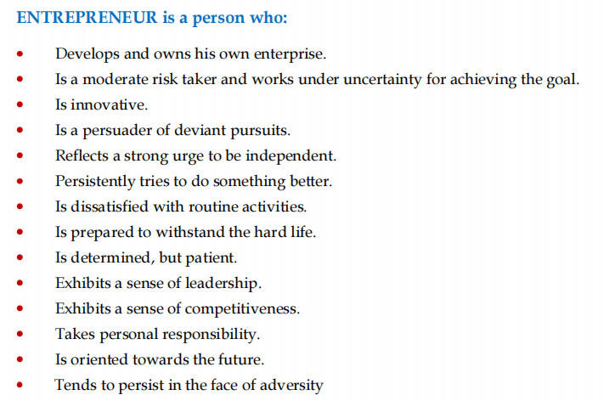

Slide 23
Barriers to Entrepreneurial
ENVIORNMENTAL BARRIERS
Raw material
Labour
Machinery
Land and Building
Infrastructure Requirements
Financial Barriers
PERSONAL BARRIERS:These barriers are caused by emotional blocks of an individual.
Lack of Confidence
Lack of dependability on others
Lack of Motivation
Lack of patience
Inability to Dream
Sense of embarrassment
SOCIETAL BARRIERS
Pressure from community
Pressure from Family
Pressure from peer group

Slide 24
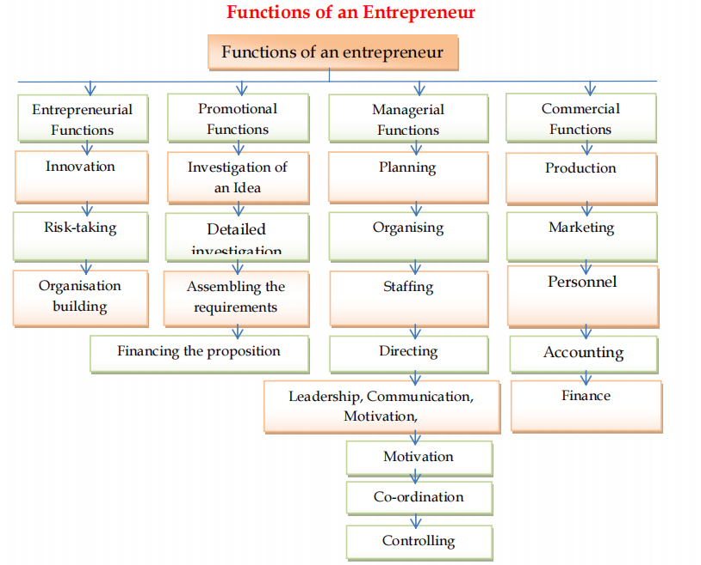

Slide 25
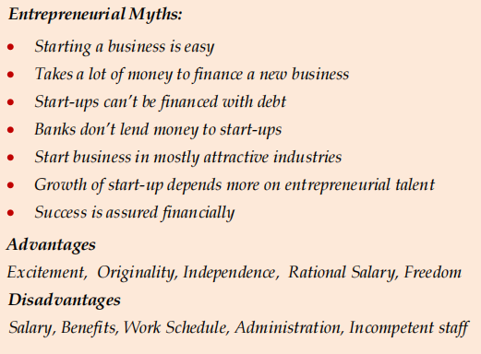

Slide 26
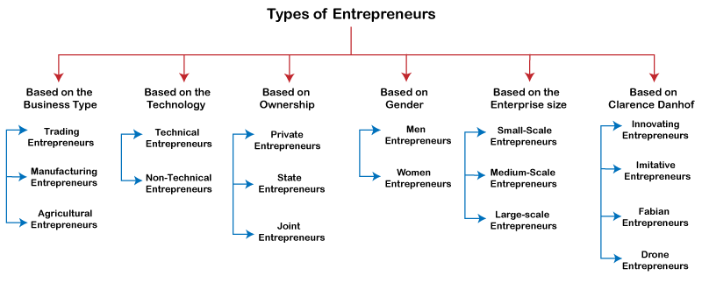
Entrepreneurship Development

Slide 27
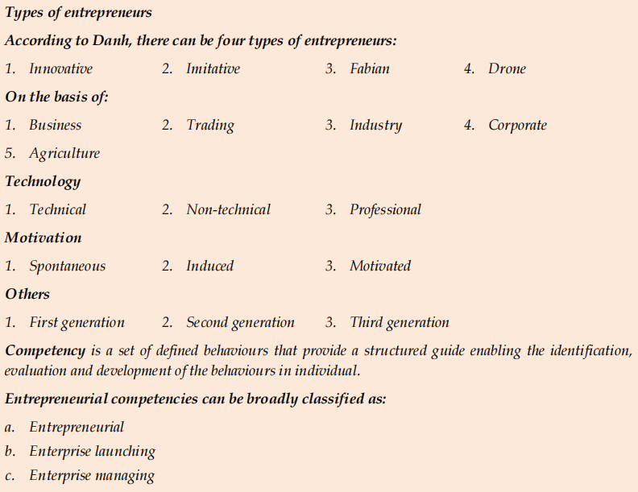

Slide 28
Types of Entrepreneurship
Small business entrepreneurship
Large company entrepreneurship
Scalable start-up entrepreneurship
International entrepreneurship
Social entrepreneurship
Environmental entrepreneurship
Technopreneurship
Hustler entrepreneurship
Innovative entrepreneurship
Imitative entrepreneurship
Researcher entrepreneurship
Cyberpreneurship

Slide 29
Varieties of Entrepreneurships
Agricultural/Rural Entrepreneurship
FarmsNFarmers.org – soil & climate conditions to farmers
Barrix.in – pheromone based pest control
Industrial entrepreneurship
Technopreneurship
E-bay, Amazon, Google
Netpreneurship
E-learning platforms
Netflix
Green/Environmental or Ecopreneurship
Waste Ventures – nutrient-rich organic compost from waste
Fourth Partner Energy – rooftop solar projects
Intra-corporate/firm or Intrapreneurship
Social entrepreneurship
Charity: water – clean drinking water around the world
Better World Books – reuse or recycle books to promote literacy

Slide 30
Characteristics Of Entrepreneurship
1. Systematic Activity | systematic, step-by-step and purposeful temperamental, skill and other knowledge and competency requirements can be acquired, learnt and developed
2. Lawful and Social | Purpose of entrepreneurship is creation of value for personal profit and social gain legally
3. Innovation | creation of value introduction of new products discovery of new markets and sources of supply of inputs technological breakthroughs newer forms for doing things better, cheaper, faster
4. Organiser / Leader | knowledge about availability and location of the resources the optimum way to combine them product development and development of the market for the product

Slide 31
Characteristics of entrepreneurship
Here are a few characteristics of entrepreneurship:
Creativity and innovation: Entrepreneurship is about coming up with new and creative ideas and implementing them to achieve substantial profits. For example, service innovation could be coming up with technologies to reduce cost and increase productivity.
Risk-taking ability: The willingness to bear risk is the essential characteristic of entrepreneurship. Risk occurs when you implement a new idea and it fails. Entrepreneurs take calculated risks because they enjoy the challenges that come up with implementing a new idea.
Profit-making: Except for social entrepreneurship, all other types of entrepreneurship work with the sole aim of making a profit. It is the reward that entrepreneurs get for taking a risk with a new idea.
Economic activity: Entrepreneurship involves creating, managing and running an organization. Moreover, it generates employment and ensures optimum utilization of resources to earn the maximum profit.

Slide 32
Characteristics of Entrepreneur
be passionate about achieving their goal
have a spirit of adventure
have a strong need to achieve and seek personal accomplishment
be passionate about achieving their goals
be self-confident and self-reliant
be goal-oriented
be innovative, creative, and versatile
be persistent
be hardworking and energetic
have a positive attitude
be willing to take initiative
have a strong sense of commitment

Slide 33
Entrepreneurship Development
A flow state of mind spontaneously arises when we become immersed in an activity so completely that we lose track of time.
1. Music
2. Gaming
3. Learning
4. Hobbies

Slide 34
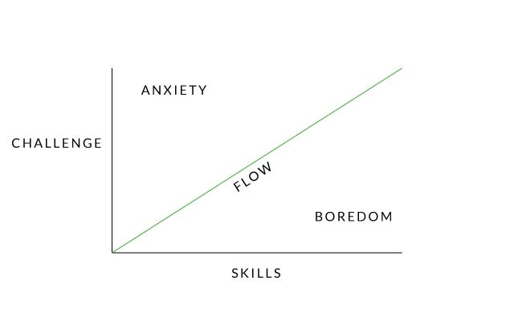
Find Your Flow
When people find their fit, they experience a state of happiness and creativity called flow.
Be honest about your strengths and weaknesses
Don’t let yourself get too comfortable
Learn to take risks

Slide 35
Entrepreneurial styles
1.Visionary Entrepreneur:
Example: Elon Musk, the founder of SpaceX and Tesla, is known for his visionary approach to space exploration and sustainable energy.
2. Serial Entrepreneur:
Example: Richard Branson, the founder of the Virgin Group, has started numerous businesses in various industries, including music, airlines, telecommunications
3. Lifestyle Entrepreneur:
Example: Tim Ferriss, known for his book "The 4-Hour Workweek," promotes a lifestyle that combines entrepreneurship with personal freedom and travel.
4. Social Entrepreneur:
Example: Blake Mycoskie, the founder of TOMS Shoes, built a business model around the concept of "One for One," where for every pair of shoes sold, a pair is donated to a child in need.

Slide 36
5.Opportunistic Entrepreneur:
Example: Nick D'Aloisio created Summly, a news summarization app, when he was just 15 years old after recognizing the need for concise news summaries on mobile devices. Yahoo later acquired his company.
6.Innovator/Inventor:
Example: Steve Jobs, co-founder of Apple Inc., was known for his innovative products such as the iPhone, iPad, and Macintosh computer.
7.Franchise Entrepreneur:
Example: Ray Kroc, who turned McDonald's into a global fast-food franchise, is a classic example of a franchise entrepreneur.
8.Solo Entrepreneur/Solopreneur:
Example: Pat Flynn, the creator of Smart Passive Income, runs a successful online business independently, focusing on passive income strategies.

Slide 37
9.Growth-Oriented Entrepreneur:
Example: Jeff Bezos, the founder of Amazon, is a growth-oriented entrepreneur who aggressively expanded his company from an online bookstore into a global e-commerce and technology giant.
10.Niche Specialist:
Example: Brian Dean, founder of Backlinko, specializes in search engine optimization (SEO) and provides in-depth content and resources to a niche audience within the digital marketing space.
11.Tech Entrepreneur:
Example: Mark Zuckerberg, co-founder of Facebook (now Meta Platforms, Inc.), started a social media platform that has transformed the way people connect and share information online.
12.Collaborative Entrepreneur:
Example: Larry Page and Sergey Brin co-founded Google, which has formed numerous partnerships and collaborations with other technology companies and organizations over the years.

Slide 38
Entrepreneurial style
CREATOR “Create a better product” Bill Gates, Steve Jobs, Richard
SUPPORTER “Leading the Team” Jack Welch, Meg Whitman
DEAL MAKER “Bringing People Together” Donald Trump, Rupert Murdoch
TRADER “Buying Low, Selling High” George Soros, John Templeton
ACCUMULATOR “Collecting Appreciating Assets” Warren Buffet
LORD “Controlling Cash Generating Assets” Andrew Carnegie
MECHANIC “Creating a Better System” Henry Ford, Ingvar Kamprad (IKEA),

Slide 39
The Principles of Effectuation
Effectuation is a way of thinking and decision-making that is based on the idea that entrepreneurs create their future by taking action and making things happen.
Bird In Hand Principle
Affordable Loss Principle
Crazy Quilt Principle
Lemonade Principle
Pilot in the Plane Principle
Effectual Cycle

Slide 40
Bird In Hand Principle
When expert entrepreneurs seek to build a new venture, they start with their means. These means can be grouped into three categories:
Who I am—my traits, tastes, and abilities
What I know—my education, training, expertise, and experience
Who I know—my social and professional networks.
Using a combination of these means, the entrepreneur begins to imagine possibilities and take action.

Slide 41
Affordable Loss Principle
In much of the business world, the manager in charge of launching a new product analyses the market and chooses segments with the highest expected value. It is a natural reflex that is the result of years of training around a single mantra: maximize returns by selecting the optimal strategy for your target. Expert entrepreneurs turn this logic on its head—they think in terms of affordable loss rather than expected returns.

Slide 42
Crazy Quilt Principle
The crazy quilt principle of effectual reasoning is the focus on building partnerships rather than beating competitors. Since entrepreneurs tend to start the process without assuming the existence of a predetermined market for their idea, they don’t know who their competitors will be, so detailed competitive analyses have little value. Instead, entrepreneurs generally take the product to the nearest potential customer.

Slide 43
Lemonade Principle
If you come across lemons, make lemonade! The third principle of effectual reasoning is at the heart of entrepreneurial expertise—the ability to turn the unexpected into the profitable. Expert entrepreneurs learn not only to work with surprises but also to take advantage of them.

Slide 44
Pilot in the Plane Principle
The struggle for personal control is as old as humankind itself—primitive and innate. There is abundant evidence that most people desire control of the events in their lives, indeed over their lives, and that such strivings for control span history and cultures.
Focus on today, not next year.

Slide 45
Effectual Cycle
The entrepreneur’s means provide the starting point. The action begins in earnest when the entrepreneur begins interacting with people. Sometimes the starting point of that interaction is an idea, a provisional goal the entrepreneur uses to initiate the interaction and complete the cycle.

Slide 46
Business Activities

Slide 47
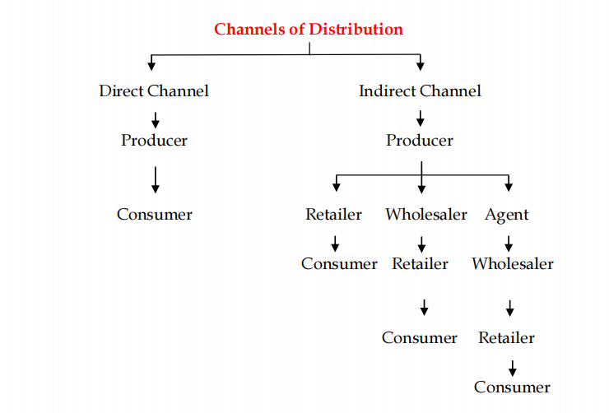

Slide 48
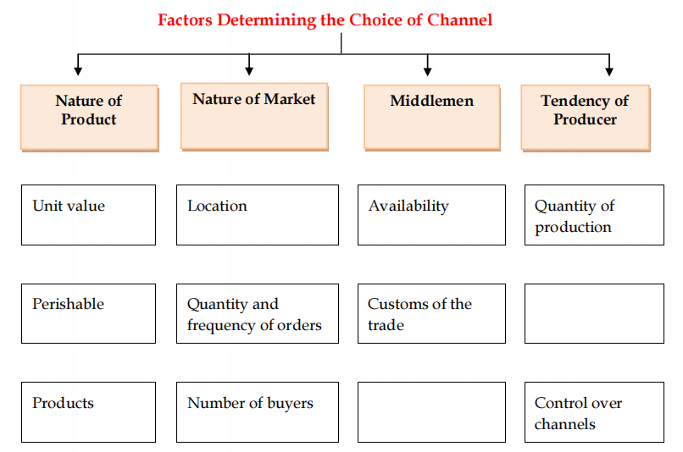

Slide 49
Startup Accelerator Chamber of Commerce
Business Model Canvas
Entrepreneurship Development

